Slide 1
Trauma informed practice An introduction for those who have safeguarding responsibilities in church life
Andrea King and Rachel Stone
June 2020

Slide 2
Today’s session aims to:
Introduce you to the concept of trauma informed practice in safeguarding situations
Help you understand the wide range of factors that can lead to trauma in childhood and beyond
Understand the impact of trauma on behaviour
Consider how best to support those who have experienced trauma either as children or who are currently experiencing trauma
Consider the specific implications for those who hold safeguarding responsibilities in Baptist churches

Slide 4
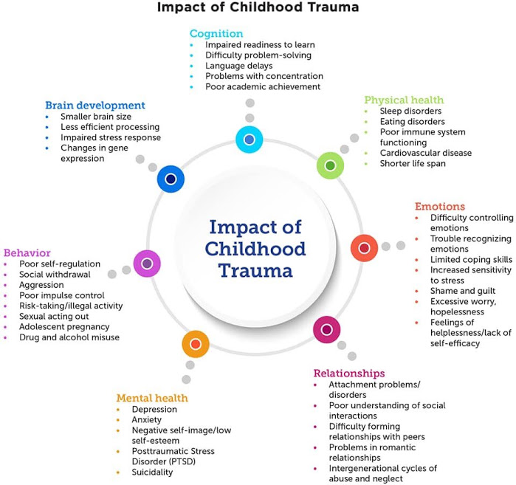

Slide 5
What you’re likely to see
Difficulties with concentration and indecisiveness
Sudden flashbacks which can be caused by related sights, sounds or smells
Avoiding places, people or objects which remind them of the incident
Feeling insecure and unsafe
Physical effects such as feeling unwell, headaches, listlessness or over activity
Difficulty in accepting the events or how they have been affected by them e.g. appearing ‘over-brave’
Changes in personality e.g. feeling depressed or isolated, becoming irritable or angry
Needing to go over and over the incident which can test the patience of those closest.
Worries that the same event might happen again or happen to them. A sense of guilt — ’If only I had…’
Fear, aggression, sudden outbursts

Slide 6
Protective Factors
This is not a predictive model
This does not speak to individual character and resilience
We know the value of protective factors
It should not be equated with loss of hope

Slide 7
What to do
Enable calming
Support the individual to develop strategies to calm him/herself down, and consider who would be best placed to help the individual stay calm, e.g. significant others, person of trust.
Encourage the individual to engage in activities that will help him/her calm down.
Consider what the church can do to make the individual feel safer, as he/she may be worried that the event will occur again.
The person providing pastoral support helps us to understand that the individual(s) may need initial support to make a plan, and ongoing support to implement and review this.
Remember, the individual(s) may need reassurance and someone to listen to his/her concerns
Encourage optimism and seek wider support

Slide 8
Further reading
This helpful leaflet provides an explanation of how adversity and trauma affect young people:
https://youngminds.org.uk/media/3091/adversity-and-trauma-informed-practice-guide-for-professionals.pdf
This Photo by Unknown Author is licensed under CC BY-NC

